Slide 1
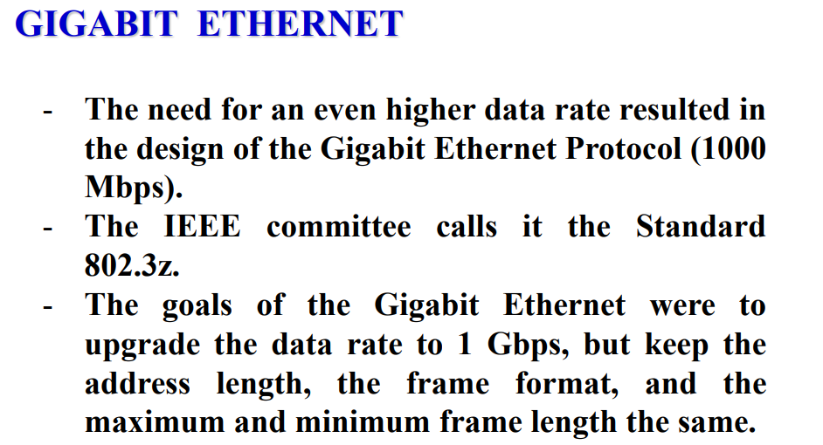

Slide 2
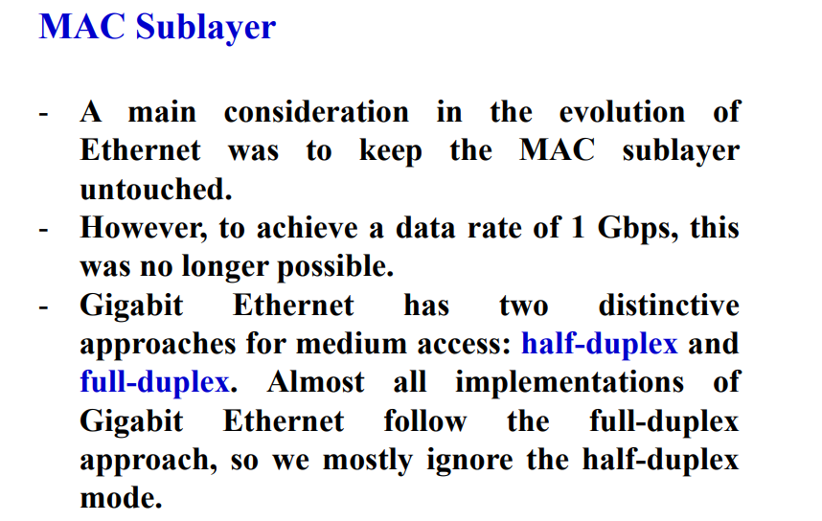

Slide 3
Carrier Extension
Gigabit Ethernet maintains the minimum and maximum frame sizes of Ethernet.
Since, Gigabit Ethernet is 10 times faster than Fast Ethernet, to maintain the same slot size, maximum cable length would have to be reduced to about 10 meters, which is not very useful.
Instead, Gigabit Ethernet uses a minimum length of frame size of 512 bytes.
To maintain compatibility with Ethernet, the minimum frame size is not increased, but the "carrier event" is extended.
If the frame is shorter than 512 bytes, then it is padded with extension symbols.
These are special symbols, which cannot occur in the payload. This process is called Carrier Extension.

Slide 4
Frame bursting
Frame Bursting is an extension of Carrier Extension.
Instead of adding an extension to each frame, multiple frames are sent.
To make theses multiple frames look like one frame, padding is added between frames so that the channel is not idle.

Slide 5
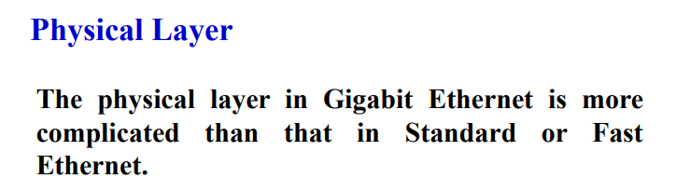

Slide 6
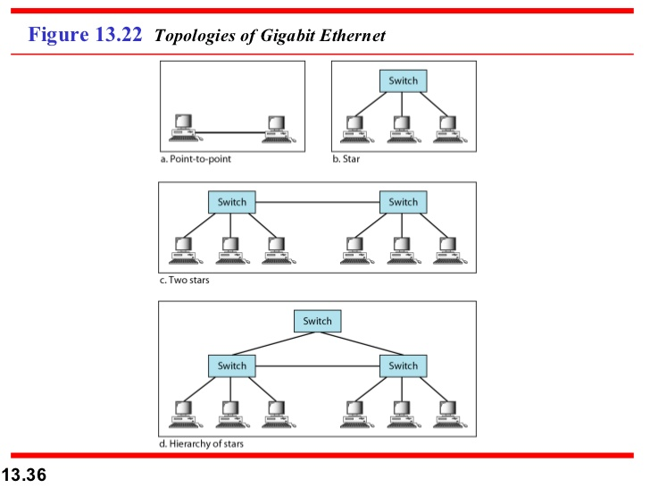
Topology

Slide 7
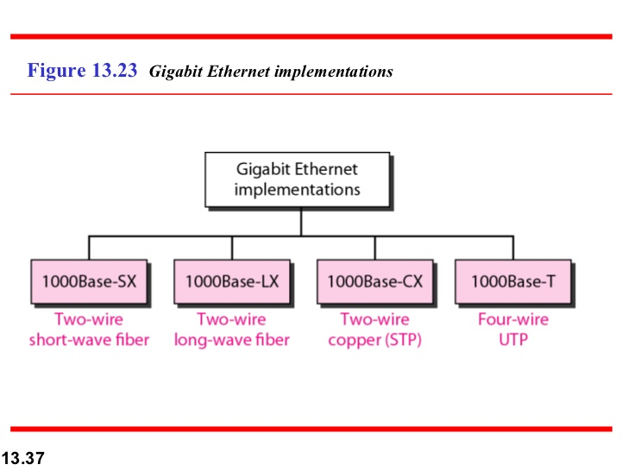

Slide 8
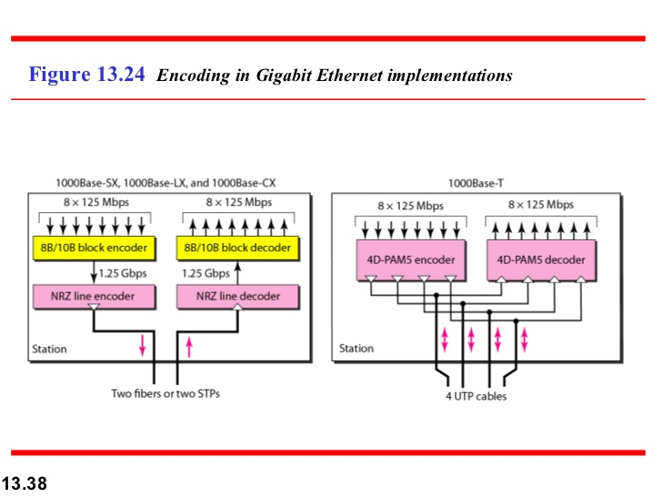

Slide 9
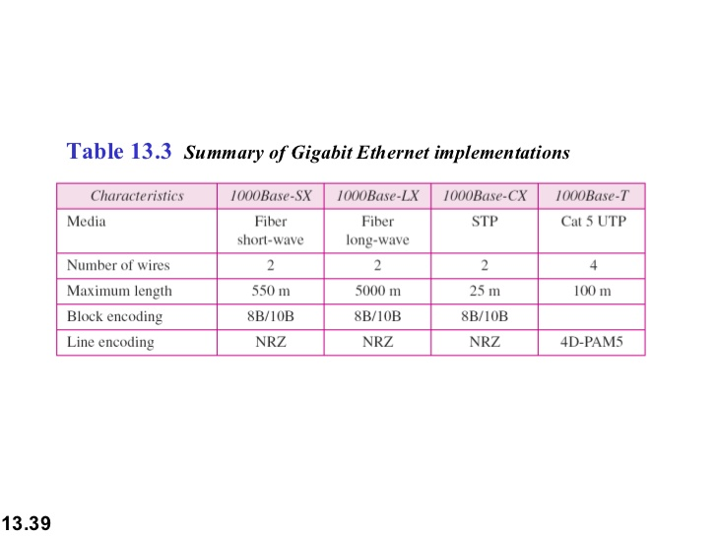

Slide 10
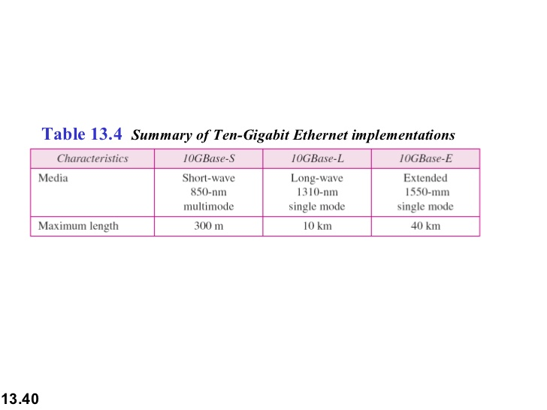
10-gigabit Ethernet: Data rate 10Gbps

Slide 11
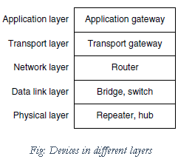
Bridges & Switches

Slide 12
Bridge:
A bridge connects two or more LANs. It operates at data link layer.
Like a hub, a modern bridge has multiple ports, usually enough for 4 to 48 input lines of a certain type. Unlike in a hub, each port is isolated to be its own collision domain.
When a frame arrives, the bridge extracts the destination address (for Ethernet, it is 48 bit) from the frame header and looks it up in a table to see where to send the frame.
The bridge only outputs the frame on the port where it is needed and can forward multiple frames at the same time.
Filtering, forwarding and blocking of frames are functions of bridges.

Slide 13
Bridges offer much better performance than hubs and the isolation between bridge ports also means that the input lines may run at different speeds, possibly even with different network types. A common example is a bridge with ports that connect to 10-, 100-, and 1000-Mbps Ethernet.
Buffering within the bridge is needed to accept a frame on one port and transmit the frame out on a different port.
Bridges were originally intended to be able to join different kinds of LANs, for example, an Ethernet and a Token Ring LAN. However, this never worked well because of differences between the LANs such as frame formats, maximum frame lengths, security and Quality of service.

Slide 14
Types of Bridges
Transparent bridge—
A transparent bridge is invisible to the other devices on the network.
Transparent bridges perform only the function of blocking or forwarding data based on the MAC address; the devices on the network are oblivious to these bridges’ existence.
Transparent bridges are by far the most popular types of bridges.

Slide 15
Translational bridge—
A translational bridge can convert from one networking system to another.
As you might have guessed, it translates the data it receives.
Translational bridges are useful for connecting two different networks, such as Ethernet and Token Ring networks.
Depending on the direction of travel, a translational bridge can add or remove information and fields from the frame as needed.

Slide 16
Source-route bridge—
Source-route bridges were designed by IBM for use on Token Ring networks.
The source-route bridge derives its name from the fact that the entire route of the frame is embedded within the frame.
This allows the bridge to make specific decisions about how the frame should be forwarded through the network.

Slide 17
Router:
Routers are devices that connect two or more networks. It operates at network layer.
They consist of a combination of hardware and software.
The hardware can be a network server, a separate computer or a special device. The hardware includes the physical interfaces to the various networks in the internetwork.
These interfaces can be Token Ring, Ethernet, T1, Frame Relay, ATM or any other technology.
The software in a router are the operating system and the routing protocol. Management software can also be used.

Slide 18
Routers use logical and physical addressing to connect two or more logically separate networks.
The network address allows routers to calculate the optimal path to a workstation or computer.
The two methods of route discovery are Distance vector routing and Link state routing.

Slide 19
Switch:
Switches are modern bridges by another name. It acts as multiport bridge to connect devices or segments in a LAN. It operates at data link layer.
It is point to point device.
It is an intelligent device. It uses switching table to find the correct destination.
Switches are of two types:
Store-and-forward switch: It stores the frame in the input buffer until the whole packet has arrived.
Cut-through switch: It forwards the packet to the output buffer as soon as the destination address is received.
Also there are layer 2 (bridge) and layer 3 switches (kind of router). It is sophisticated and expensive device.

